Slide 1
Tour Planner Using Graphs
Vishwakarma Institute of Technology - BTech - Second Year Information Technology
Division C – Batch 1 – G1
Group Members – Guide - Prof. Pankaj Kunekar
Rahul Daga – Roll No. 15 (12210191)
Saakshi Salvi – Roll No. 25 (12210821)
Mohammad Shaikh – Roll No. 30 (12211056)
Shrid Dagwar – Roll No. 39 (12210564)
Omkar Surve – Roll No. 47 (12211732)

Slide 2

introduction
Travel Planner using Graphs involves data structures and algorithms to find the best path between locations.
Here we have implemented Dijkstra’s algorithm to find the shortest path between two locations.

Slide 3
Overview
We implemented this project using C programming.
We have used graphs particularly for this project.
Algorithm used is Dijkstra’s Algorithm for finding the shortest distance between two locations and the program will also update and print the path according to the user input locations.

Slide 4
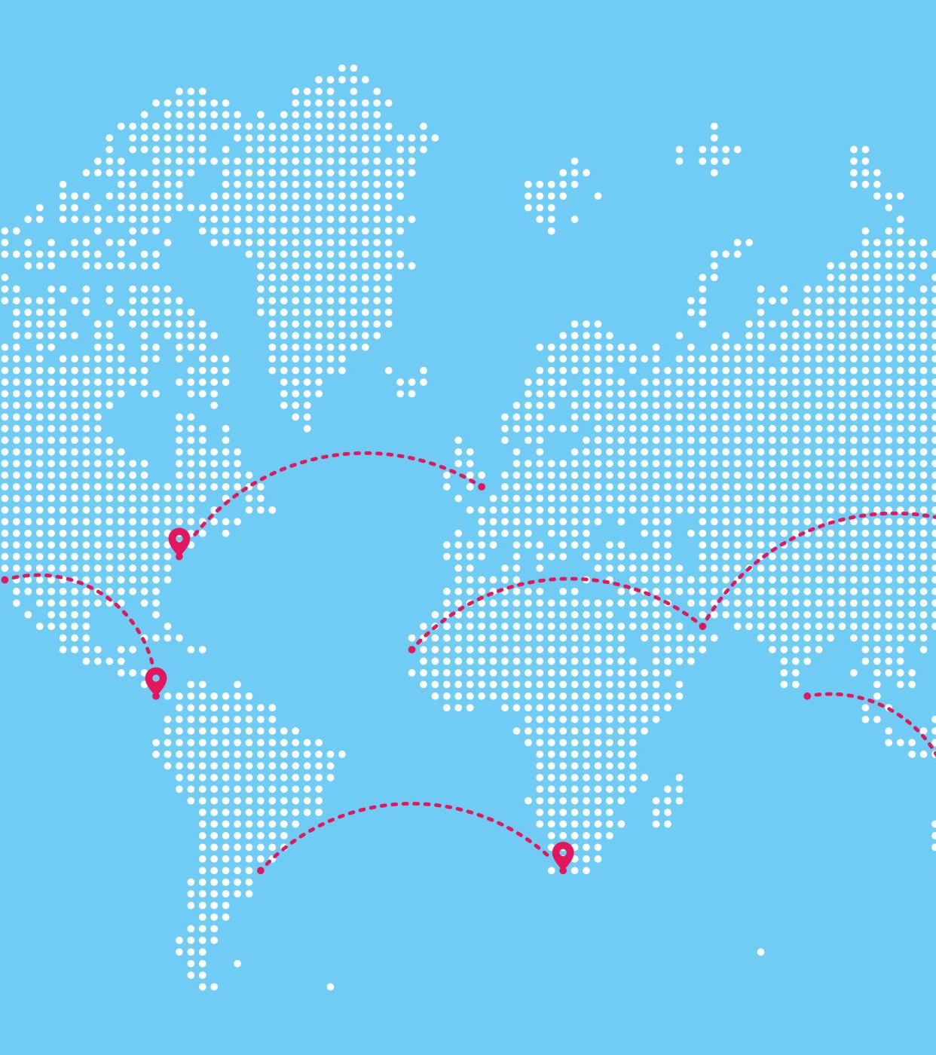
Problem statement
Implementing a Tour Planner using Graphs in Data Structures.
For someone who likes to travel a lot, there must be a travel planner who will indicate the shortest travel distance from the starting point to the destination to save time and money.

Slide 5
Dijkstra’s algorithm
It is an algorithm used for finding the shortest paths between nodes in a weighted graph, which may represent, for example, road networks.
Dijkstra’s original algorithm found the shortest path between two given nodes, but a more common variant fixes a single node as the “source” node and finds shortest path from the source to all other nodes in the graph, producing a shortest-path

Slide 6
Flow of project
Start
Enter start location(0 to 4)
Check the input if valid or not
Enter Destination Location(0 to 4)
Yes
Create Graph and locations array
No
Print the shortest path
Run Dijkstra’s Algorithm with source and destination
End

Slide 7
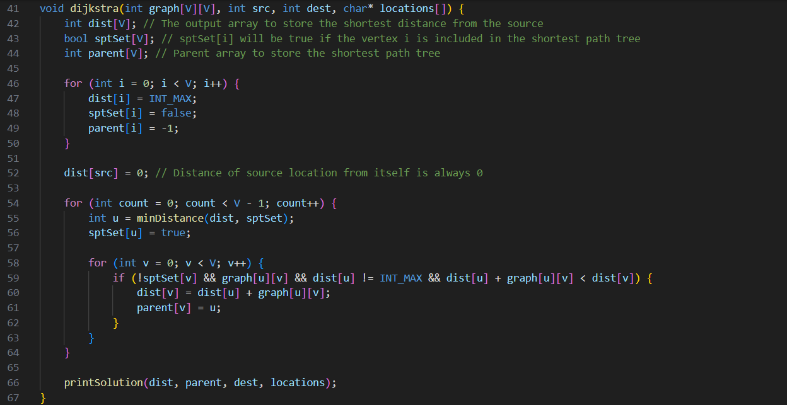
Code snips
Function of the Algorithm used:

Slide 8
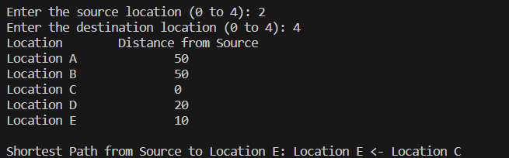
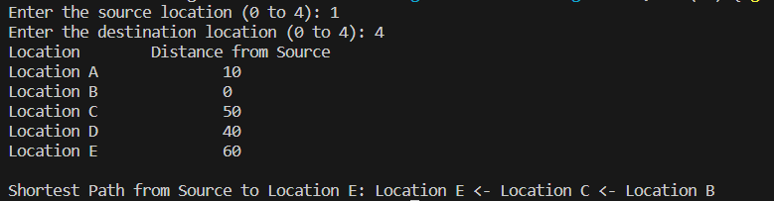
Results

Slide 9

Conclusion and future scope
In conclusion, we would say that Dijkstra’s Algorithm is the easiest way to find the shortest distance between two locations.
In our project we can also add some functions like adding new node, and then finding the distance between the start and the new location.
This project can be implemented in a wider industry as GPS system for destinations.

Slide 10

Thank you

